Slide 1


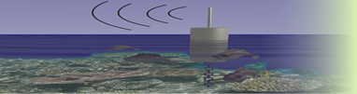




Defining cyberinfrastructure for sensor-based environmental observing systems: challenges and opportunities
Sameer Tilak, UCSD
Peter Arzberger, Tony Fountain, Gesuri Ramirez, and Peter Shin

Slide 2
Outline
Environmental Observing Systems
Streaming Data Middleware
Open Source DataTurbine Overview
Android Sensor Pod
Sensor Network Software O&M
Conclusion

Slide 3
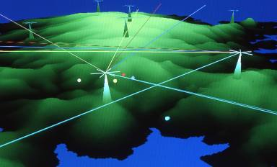
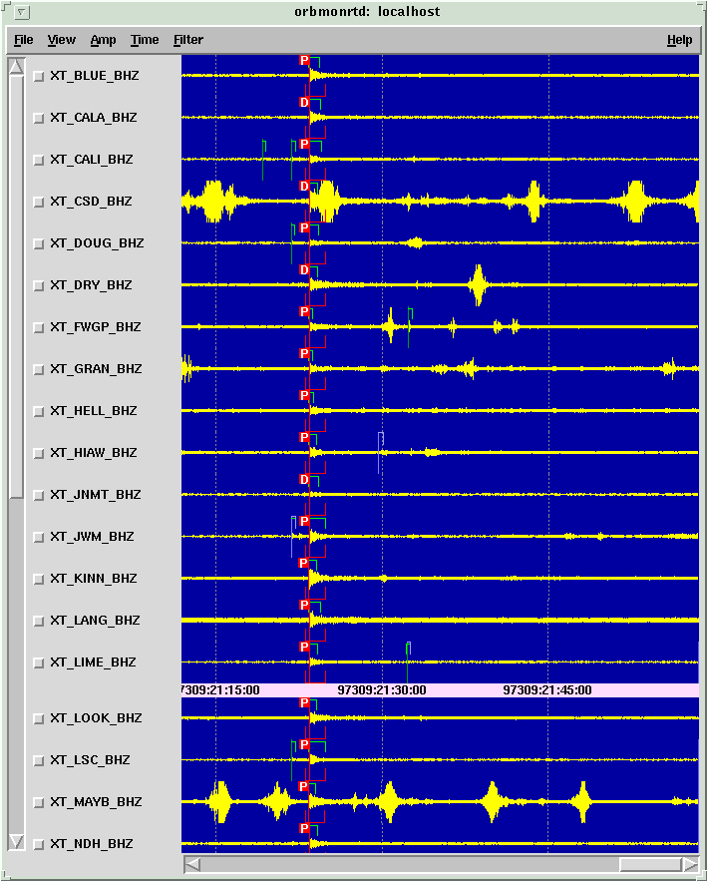
Observing Systems Approach to Environmental Science
Scientific Grand Challenges
NRC (National Research Council).
2001 Grand Challenges in Environmental Sciences
Biodiversity
Biogeochemical cycles
Climate Change
Hydroecology
Infectious Disease
Invasive Species
Land Use
Comprehensive Approach:
Real-time multi-resolution observations (sensors, imagery, labs, people)
Production of quality scientific products (synthesis, modeling, forecasts)
Collaboration across scientists, programs, agencies, countries

Slide 4
Observing Systems CI Requirements
Numerous observing systems being planned or built – from local to global
Ecology, Oceanography, Seismology, Engineering, Hydrology
All have similar CI requirements wrt data acquisition, instrument management, and state-of-health monitoring
Reliable data capture and transport
Persistent monitoring of numerous data channels
Automated processing, event detection, analysis
Integration across heterogeneous resources and systems
Real-time tasking and remote operations
Secure access to system resources
Streaming data middleware provides the framework for application development and integration

Slide 5
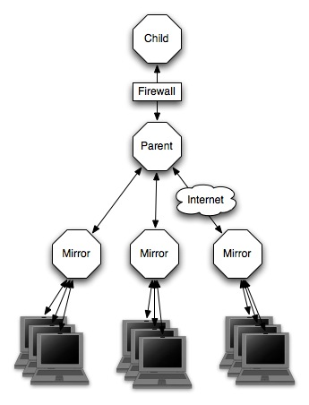
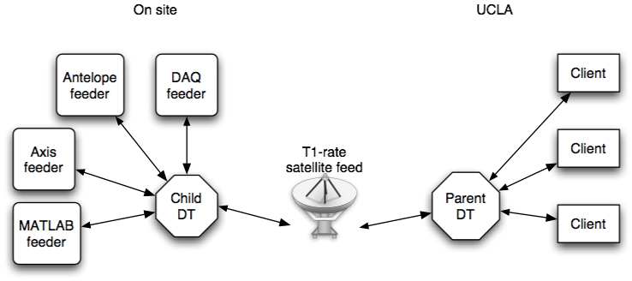
Streaming Data Middleware
Common programming layer for real-time systems
Enables integration of real-time components
Provides abstractions over vendor-specific products
Supports in-network processing (buffering, time synch …)
Make data streams first class objects
Addressable
Efficient operations
Monitoring, QA/QC
Event detection
Replication and subscription
Reliable transport

Slide 6

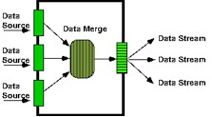
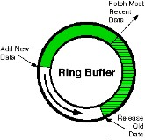
Open Source DataTurbine
Open Source Middleware for sensor networks and streaming data applications.
Provides support for integrating heterogeneous sensors and instruments.
Scalable support for in-network intelligent routing, data processing, filtering, and topology management
Originally developed by Creare Inc., http://www.creare.com/
OPEN SOURCE SOFTWARE - Apache 2.0. www.dataturbine.org

Slide 7
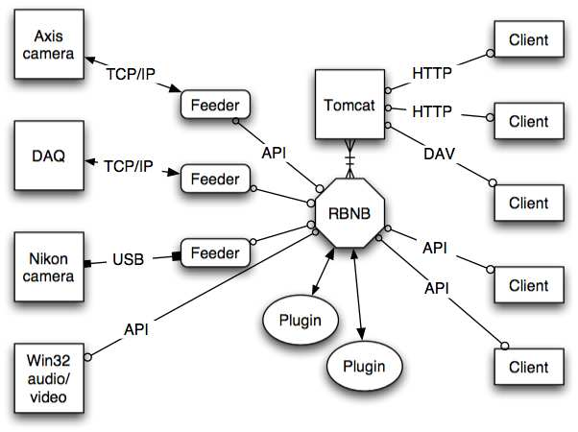
DataTurbine: Generalized Architecture

Slide 8
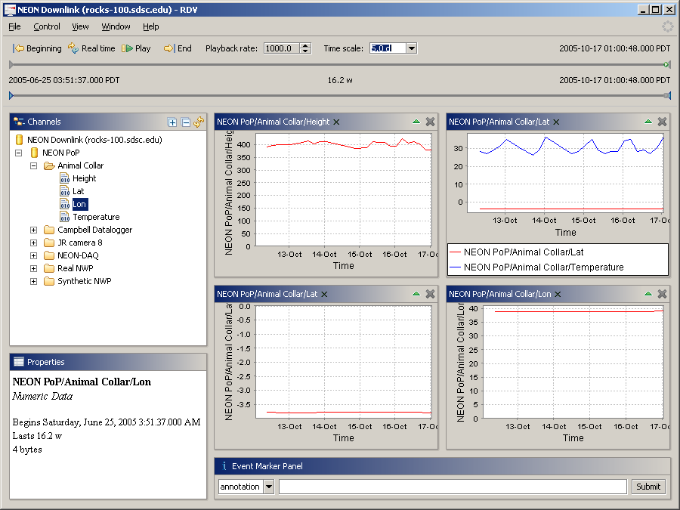
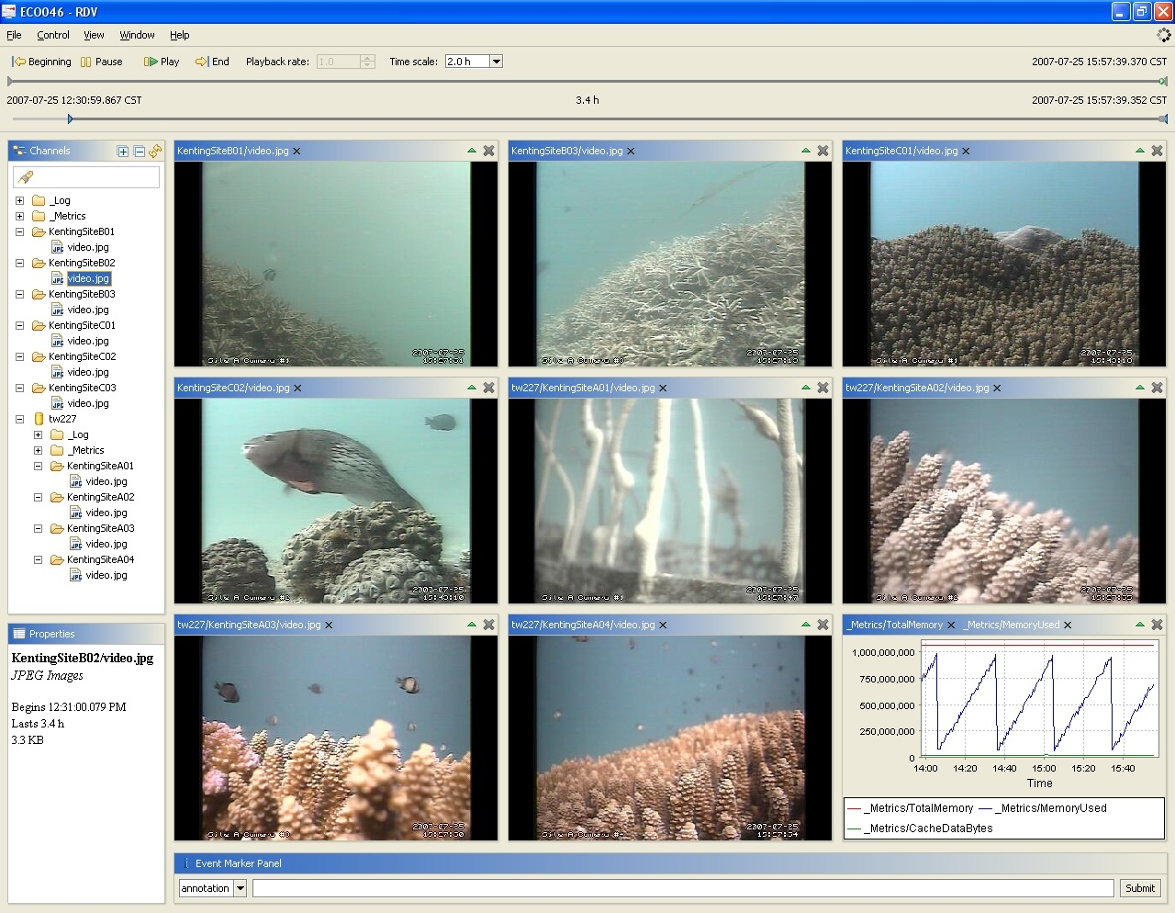
RDV – Real-time Data Viewer
Numeric Data
Image and video Data

Slide 9
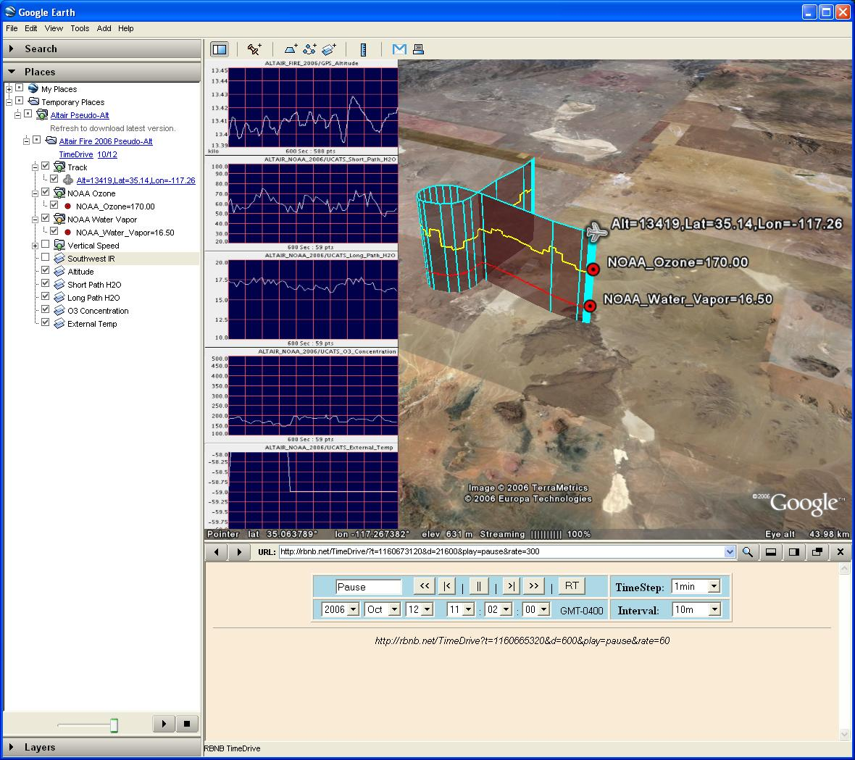
DataTurbine GoogleEarth Plug-in
Credit Matt Miller, Creare Inc.

Slide 10

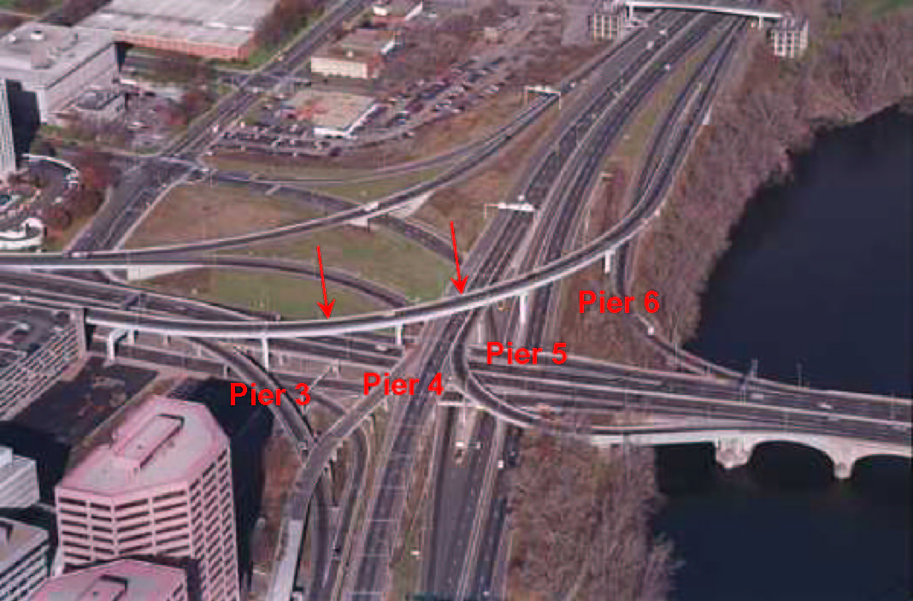
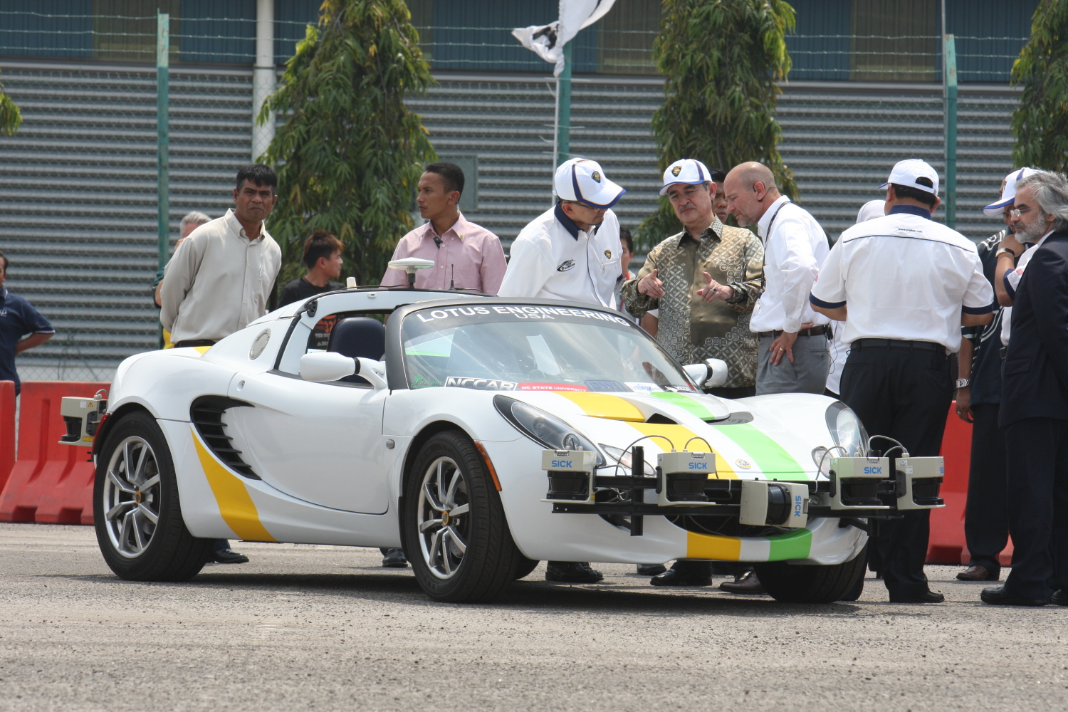
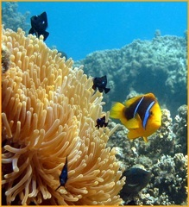
A Sampler of OSDT Applications
Structural Health Monitoring
Earthquake Engineering
Airborne Environmental Monitoring
Autonomous Vehicles
Coral Reef Monitoring
Lawrence C. Freudinger, NASA Dryden Flight Research Center
Rich Christenson, Univ. of Connecticut
Russell J. Schmitt, UCSB
Shep Pitts, Lotus Engineering and N Carolina State Univ.

Slide 11
The Open Source DataTurbine (OSDT) Android Sensor Pod: Embedded cyberinfrastructure for smart buoy controllers and experiments in ocean acidification and limnology

Slide 12
Motivation
Need to replace traditional “dumb” data loggers
Vendor Lock-in
Undocumented interfaces
No support for in-network processing (event detection)
Ad-hoc Remote system (re) configuration and debugging

Slide 13
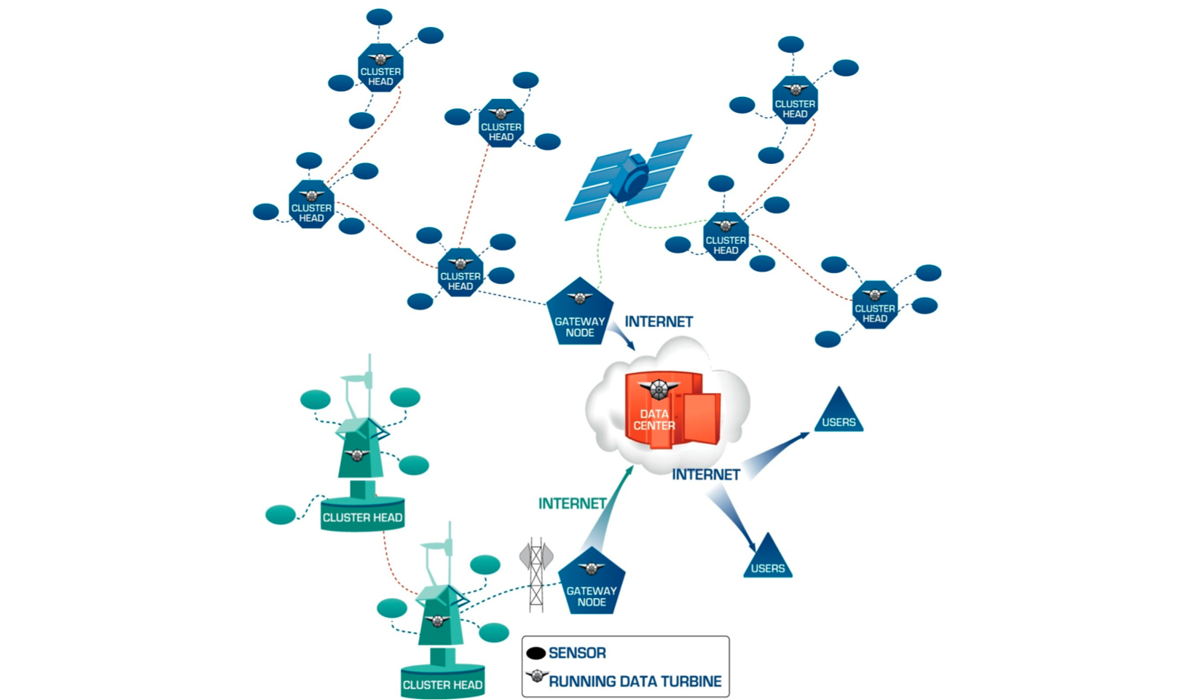
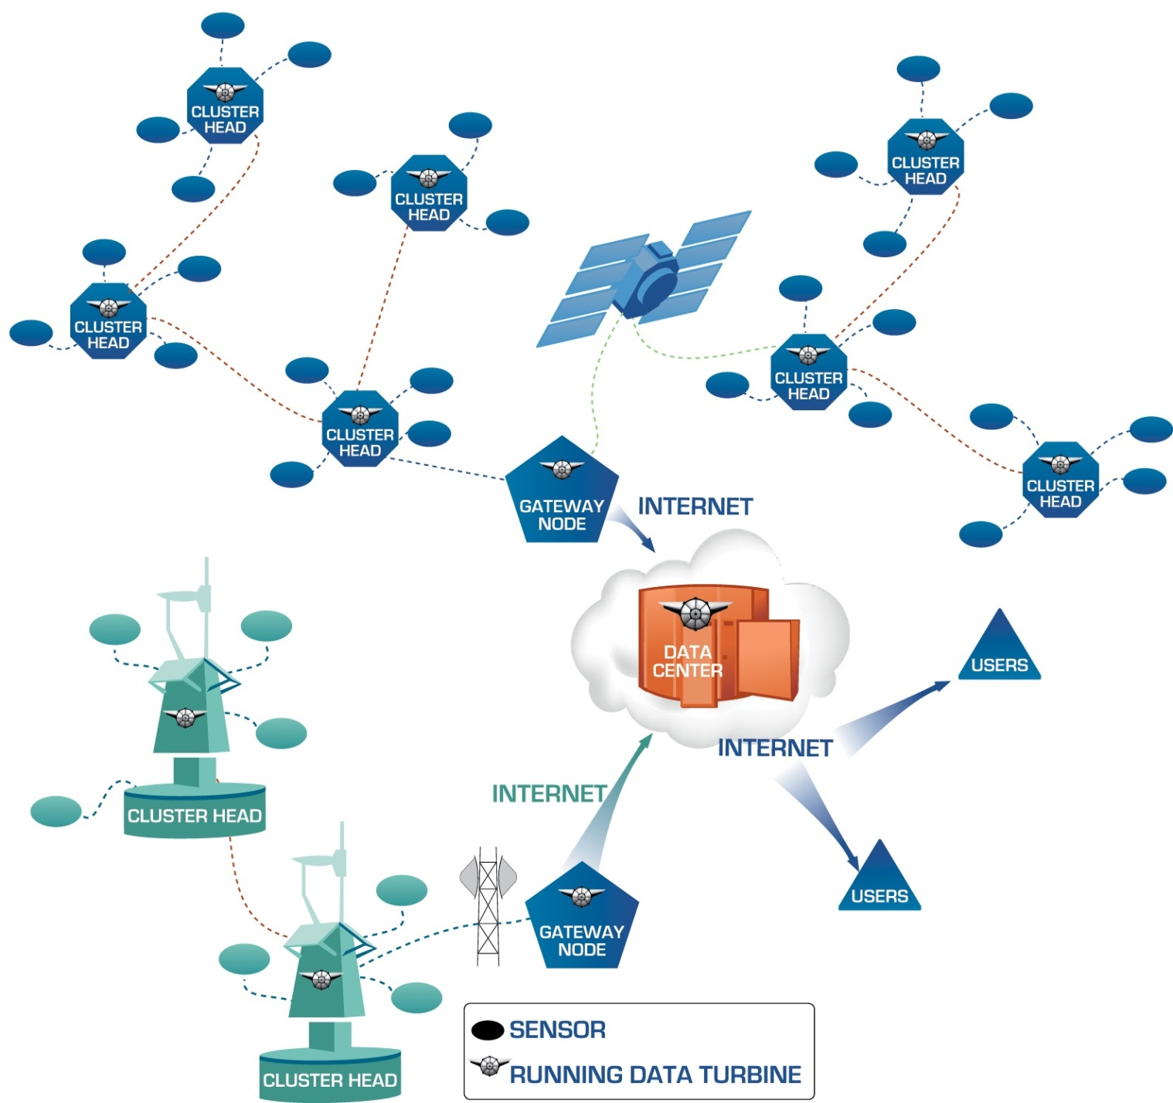
Environmental Observing Systems Architecture

Slide 14
Sensor Network deployment for Biodiversity research
Sensor Selection
Network modality selection
Software Stack Development
Sensor interface and integration
Higher-layers (data processing, storage, comm. etc.)
Software configuration
Deployment
Operation and Management
Data Center Component

Slide 15
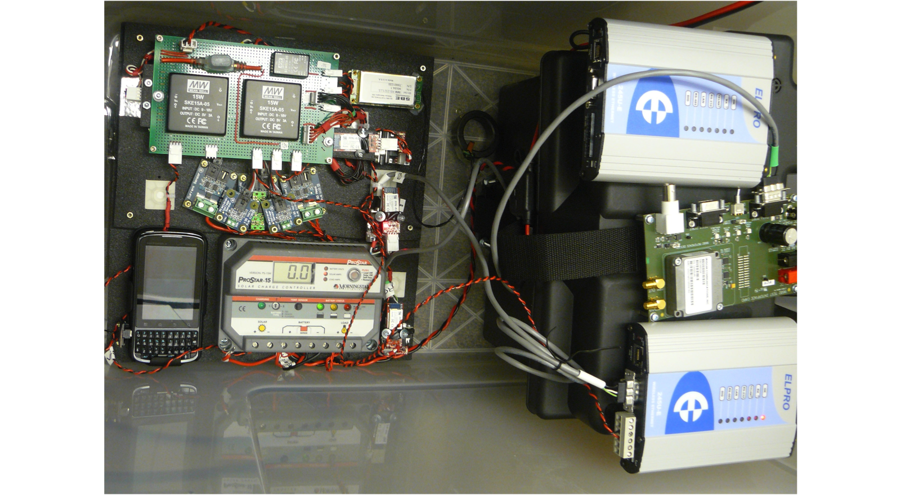
Sensor Pod Hardware
Power Supply
Wireless Radio
(shore)
Temp., Hum., Volt., Current Sensors
Serial to Bluetooth Converters
Satellite
Modem
Droid
Phone
Solar Panel
Charge Controller
Battery
Wireless Radio
(buoy)
With 2 batteries the system will remain powered for 8 days without any charge from the solar panels. A complete recharge takes approximately 4 hours depending on solar intensity.

Slide 16
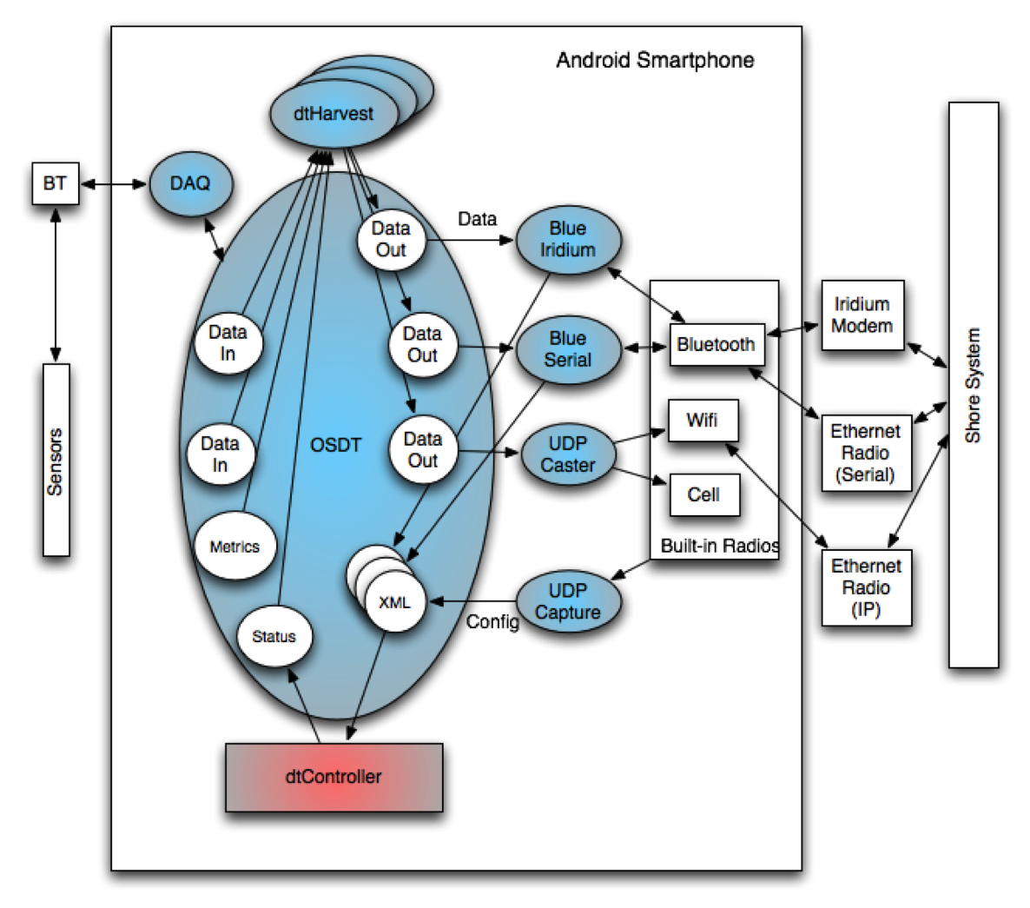
Android Sensor Pod Architecture
The OSDT Android Sensor Pod includes an integrated suite of software services running on the Android platform. The dtController performs lifecycle management of software services (shown as blue ellipses) running on the Android platform. The DAQ (data acquisition) service is an OSDT source that communicates with sensors and ingests sensor data into OSDT channels (shown as Data In) over Bluetooth. The dtHarvest services multiplex the sensor data into CSV-formatted OSDT channels (shown as Data Out). Various OSDT sink programs (e.g., UDP Caster, UDP Capture, Blue Iridium, and Blue Serial) read the Data Out channels and send data out over multiple radio interfaces.

Slide 17
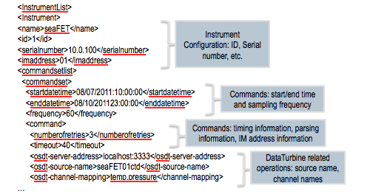
XML Configuration and Control
The Sensor Pod can be dynamically reconfigured by modifying a global XML configuration file. Common management tasks can be accomplished efficiently by on-the-fly changes to this file, e.g., adding/removing sensors, changing sample rates, modifying communication policies. This greatly simplifies system configuration and management tasks and enables new science experiments that require real-time adaptive control.
<InstrumentList>
<Instrument>
<name>seaFET</name>
<id>1</id>
<serialnumber>10.0.100</serialnumber>
<imaddress>01</imaddress>
<commandsetlist>
<commandset>
<startdatetime>08/07/2011:10:00:00</startdatetime>
<enddatetime>08/10/201123:00:00</enddatetime>
<frequency>60</frequency>
<command>
<numberofretries>3</numberofretries>
<timeout>40</timeout>
<osdt-server-address>localhost:3333</osdt-server-address>
<osdt-source-name>seaFET01ctd</osdt-source-name>
<osdt-channel-mapping>temp,pressure</channel-mapping>
…
<InstrumentList>
<Instrument>
<name>seaFET</name>
<id>1</id>
<serialnumber>10.0.100</serialnumber>
<imaddress>01</imaddress>
<commandsetlist>
<commandset>
<startdatetime>08/07/2011:10:00:00</startdatetime>
<enddatetime>08/10/201123:00:00</enddatetime>
<frequency>60</frequency>
<command>
<numberofretries>3</numberofretries>
<timeout>40</timeout>
<osdt-server-address>localhost:3333</osdt-server-address>
<osdt-source-name>seaFET01ctd</osdt-source-name>
<osdt-channel-mapping>temp,pressure</channel-mapping>
…
<InstrumentList>
<Instrument>
<name>seaFET</name>
<id>1</id>
<serialnumber>10.0.100</serialnumber>
<imaddress>01</imaddress>
<commandsetlist>
<commandset>
<startdatetime>08/07/2011:10:00:00</startdatetime>
<enddatetime>08/10/201123:00:00</enddatetime>
<frequency>60</frequency>
<command>
<numberofretries>3</numberofretries>
<timeout>40</timeout>
<osdt-server-address>localhost:3333</osdt-server-address>
<osdt-source-name>seaFET01ctd</osdt-source-name>
<osdt-channel-mapping>temp,pressure</channel-mapping>
…
<InstrumentList>
<Instrument>
<name>seaFET</name>
<id>1</id>
<serialnumber>10.0.100</serialnumber>
<imaddress>01</imaddress>
<commandsetlist>
<commandset>
<startdatetime>08/07/2011:10:00:00</startdatetime>
<enddatetime>08/10/201123:00:00</enddatetime>
<frequency>60</frequency>
<command>
<numberofretries>3</numberofretries>
<timeout>40</timeout>
<osdt-server-address>localhost:3333</osdt-server-address>
<osdt-source-name>seaFET01ctd</osdt-source-name>
<osdt-channel-mapping>temp,pressure</channel-mapping>
…
<InstrumentList>
<Instrument>
<name>seaFET</name>
<id>1</id>
<serialnumber>10.0.100</serialnumber>
<imaddress>01</imaddress>
<commandsetlist>
<commandset>
<startdatetime>08/07/2011:10:00:00</startdatetime>
<enddatetime>08/10/201123:00:00</enddatetime>
<frequency>60</frequency>
<command>
<numberofretries>3</numberofretries>
<timeout>40</timeout>
<osdt-server-address>localhost:3333</osdt-server-address>
<osdt-source-name>seaFET01ctd</osdt-source-name>
<osdt-channel-mapping>temp,pressure</channel-mapping>
…
Instrument
Configuration: ID, Serial number, etc.
Instrument
Configuration: ID, Serial number, etc.
Commands: start/end time and sampling frequency
Commands: start/end time and sampling frequency
Commands: timing information, parsing information, IM address information
Commands: timing information, parsing information, IM address information
DataTurbine related operations: source name, channel names
DataTurbine related operations: source name, channel names

Slide 18
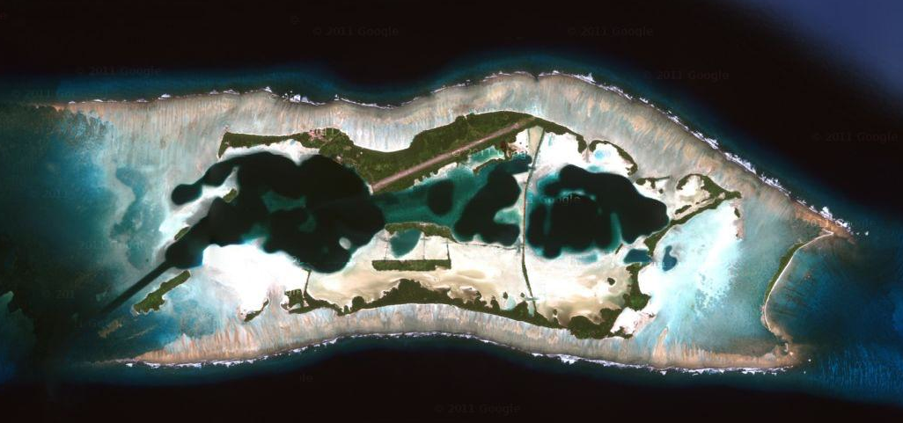
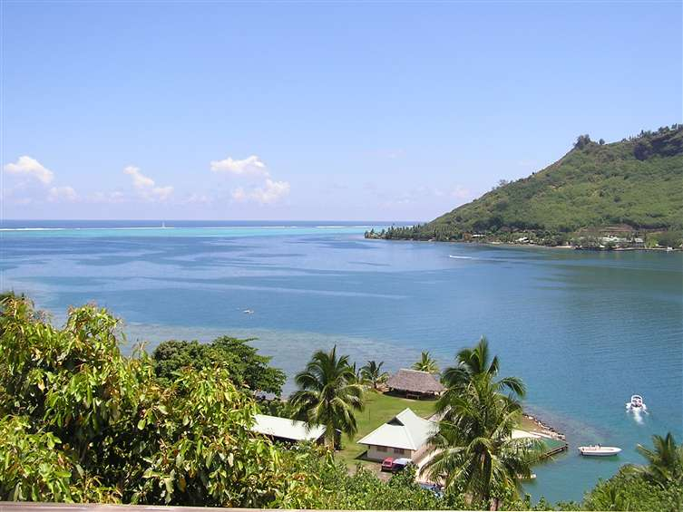
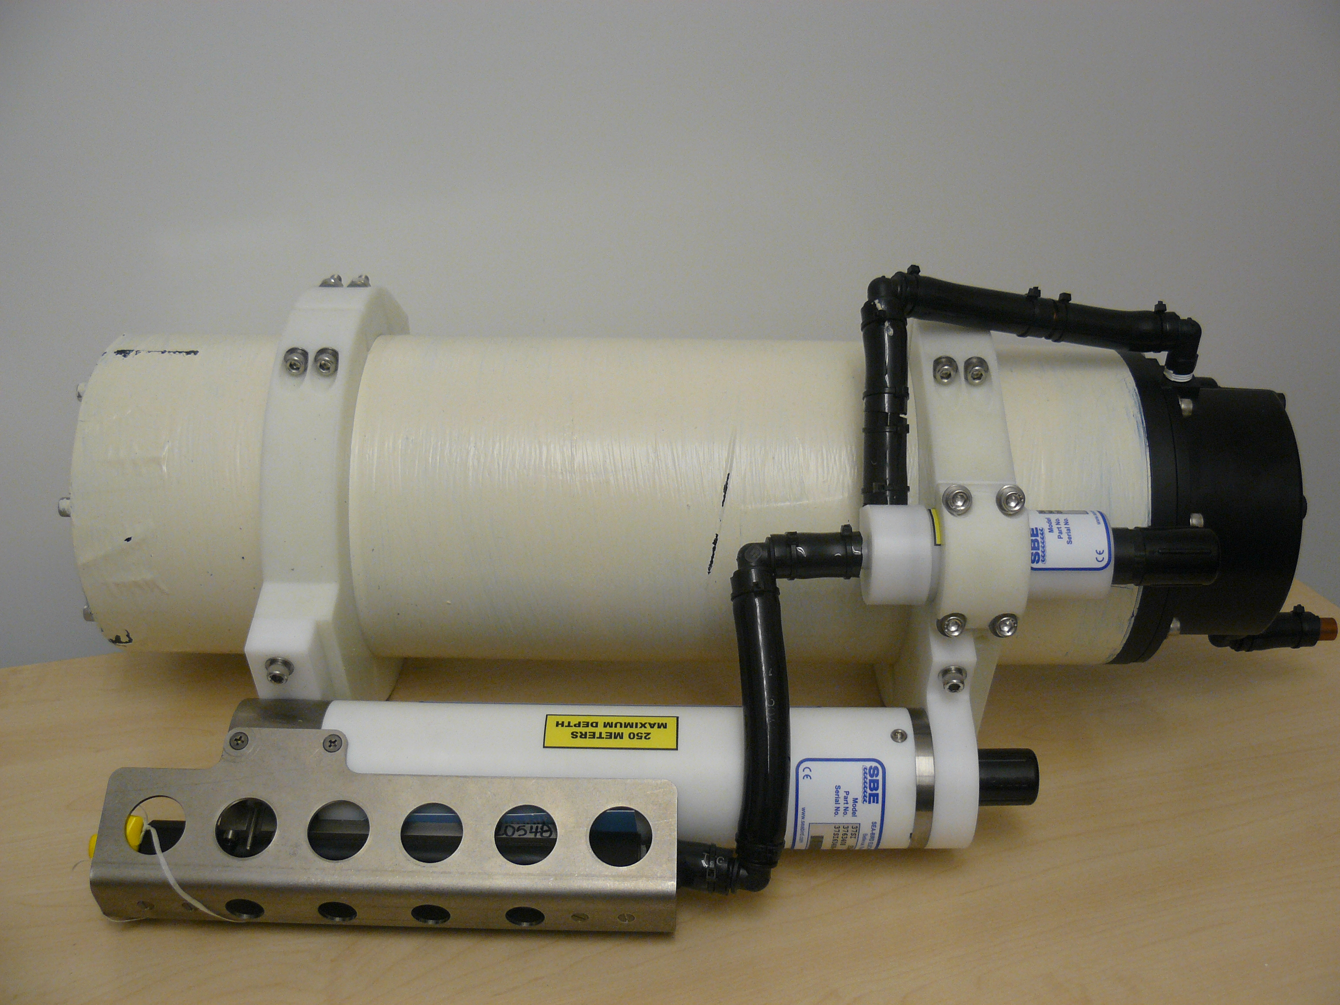
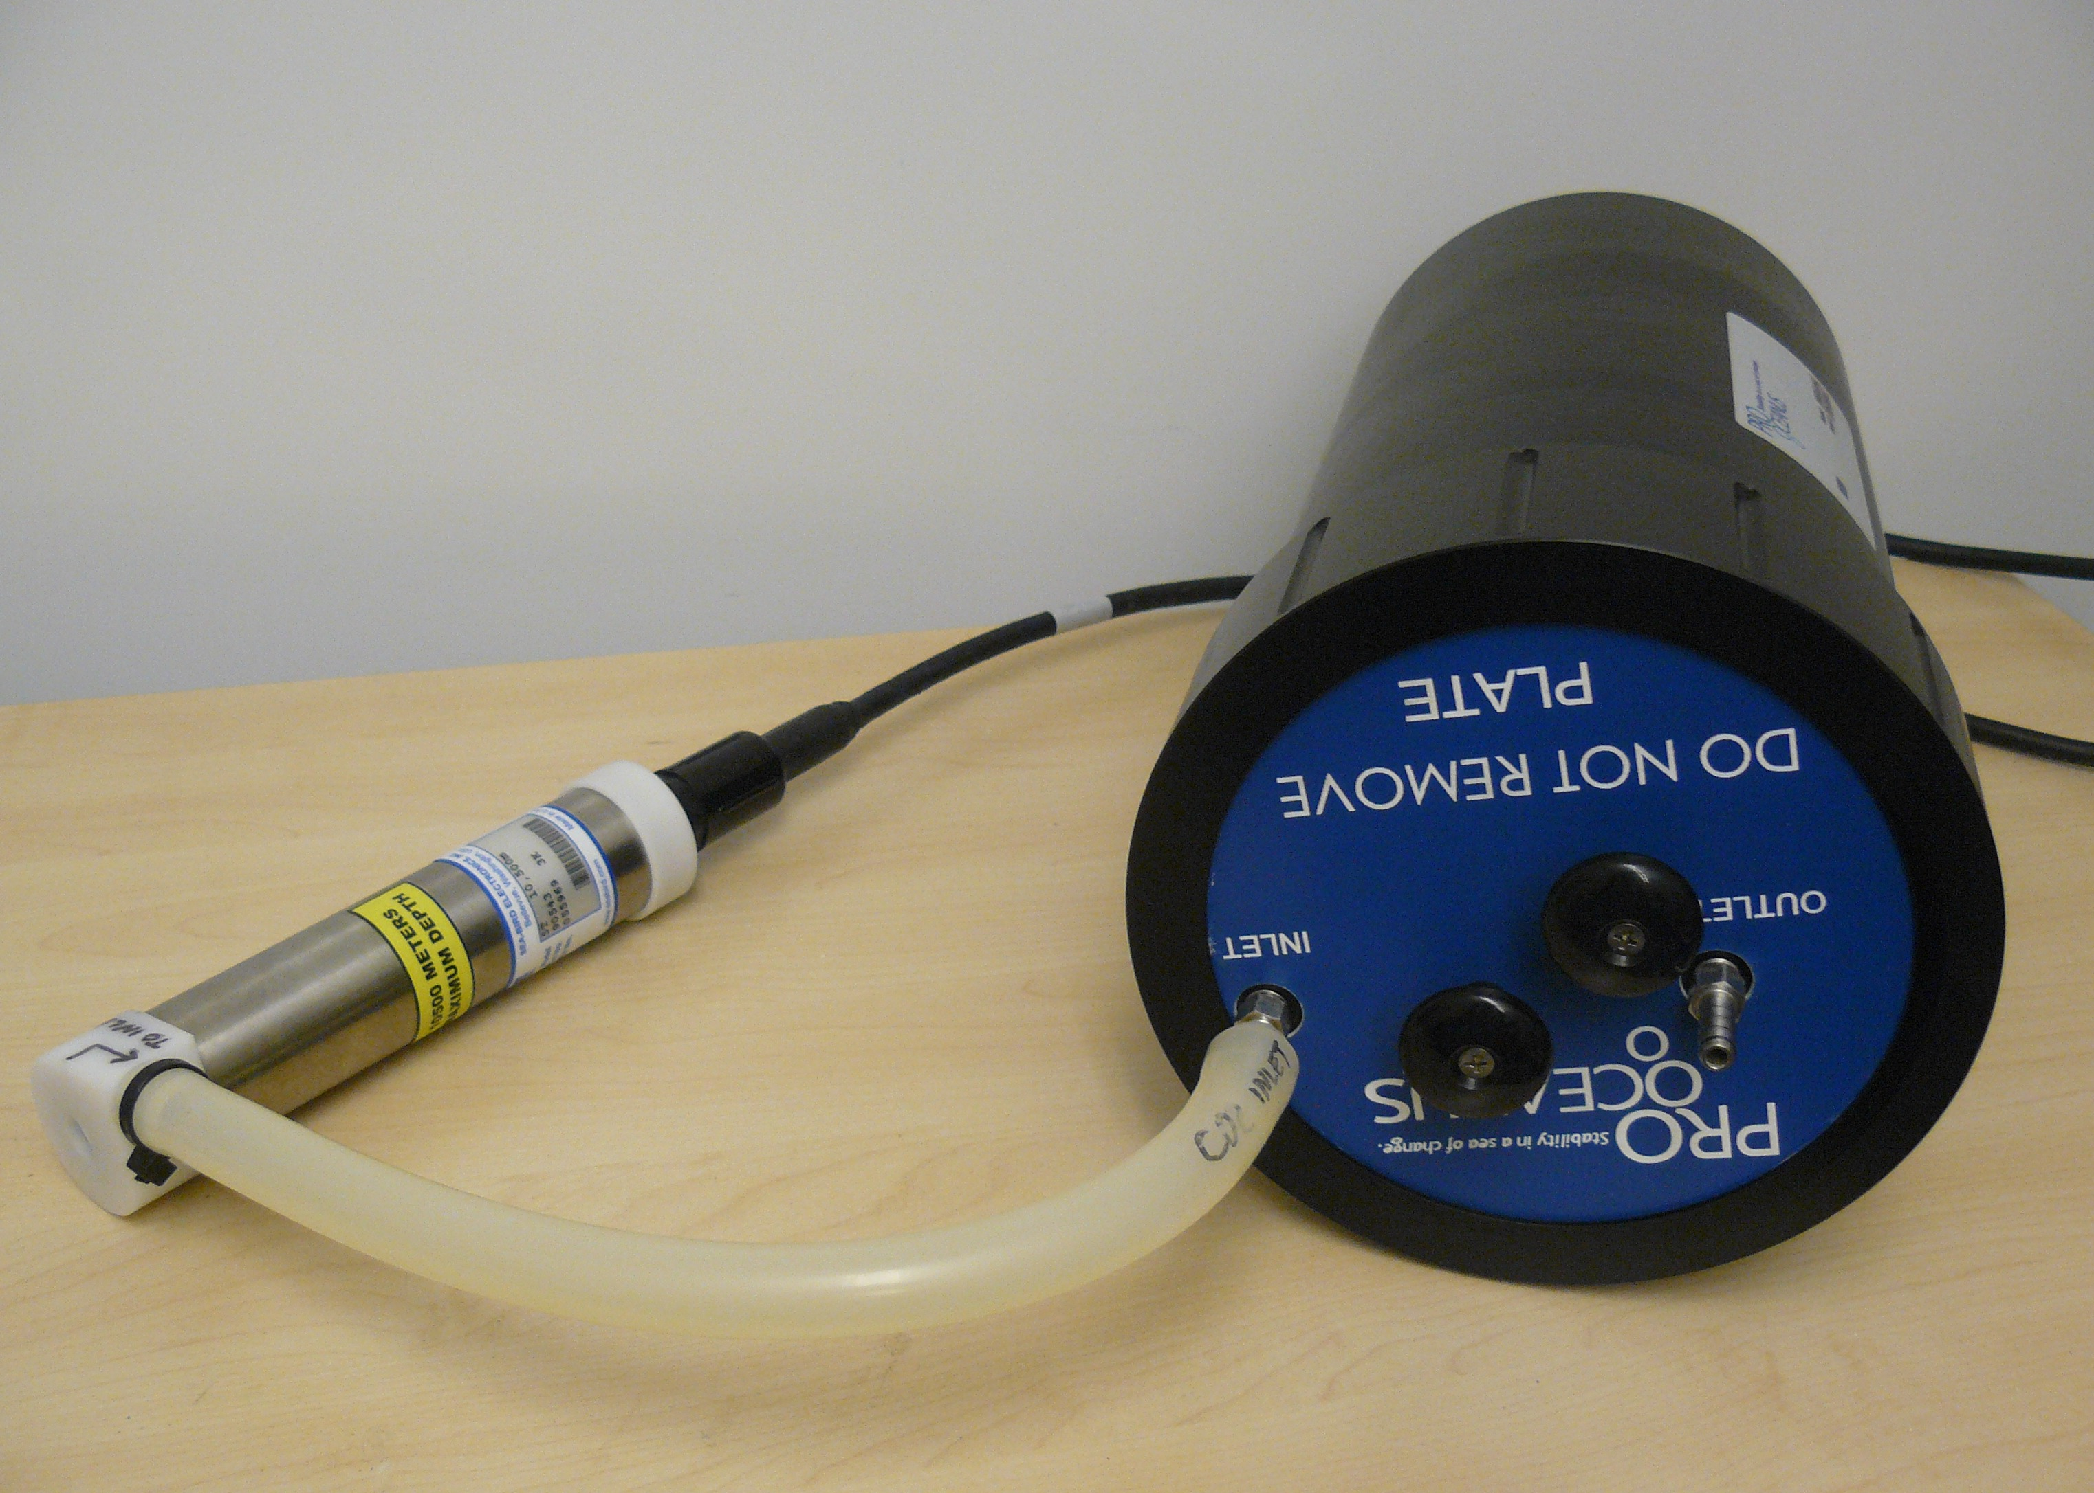
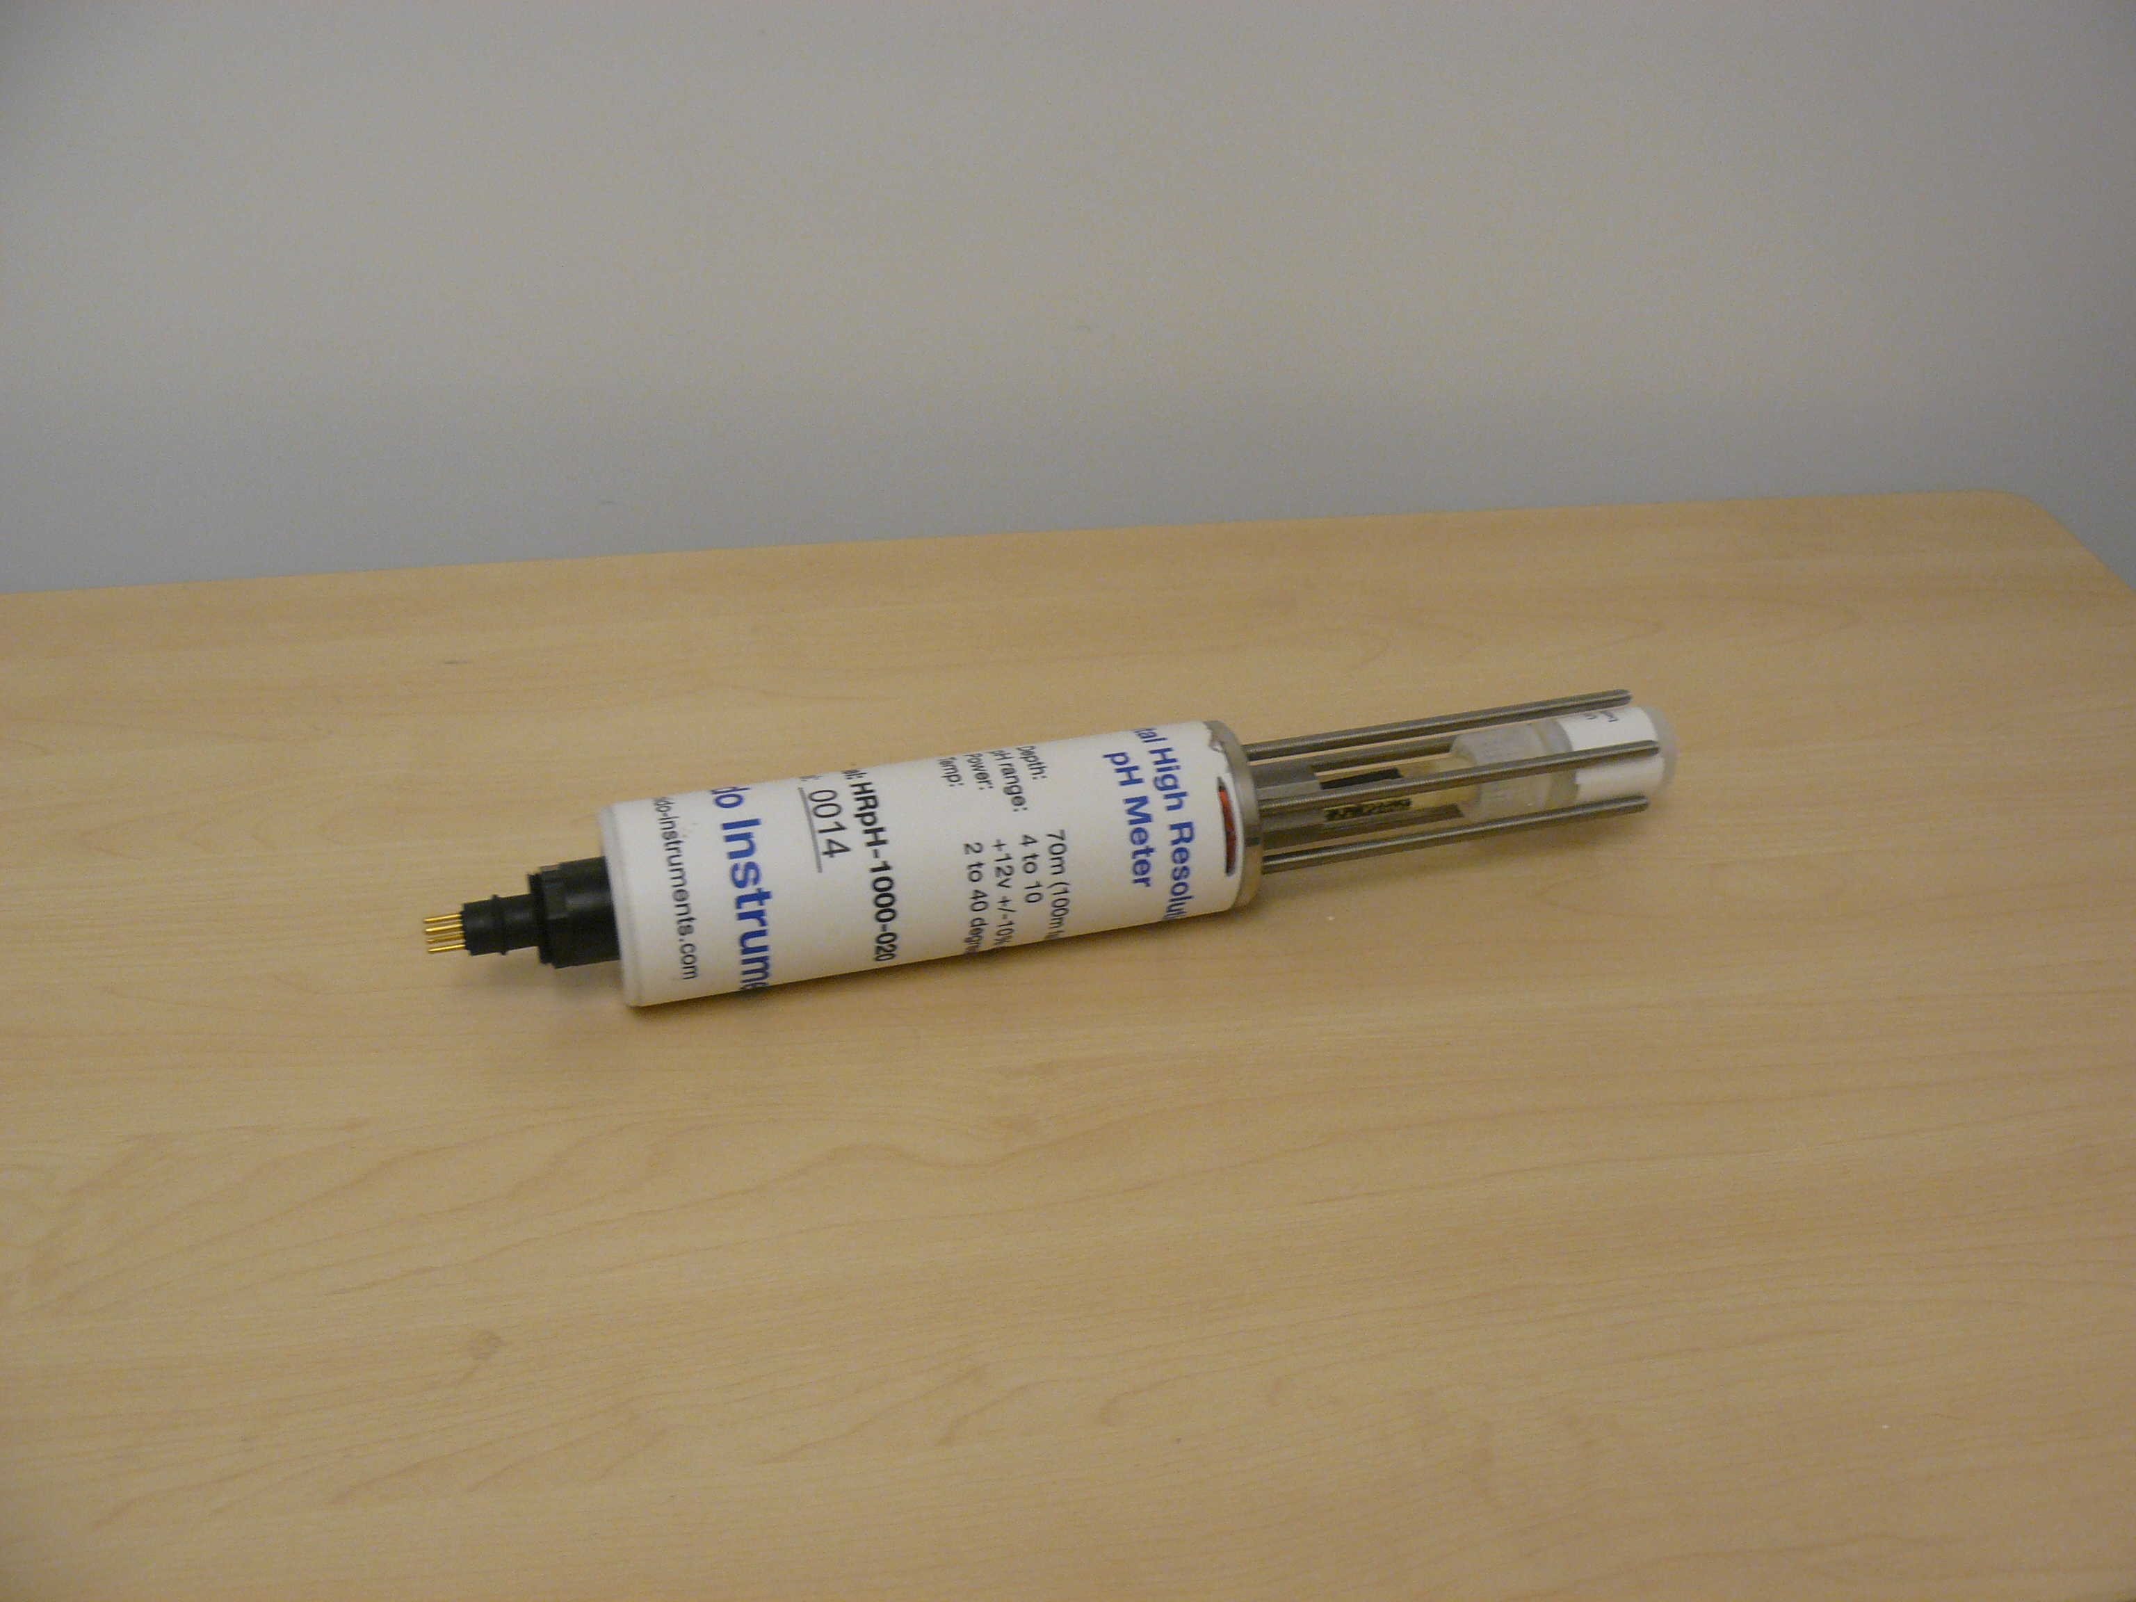
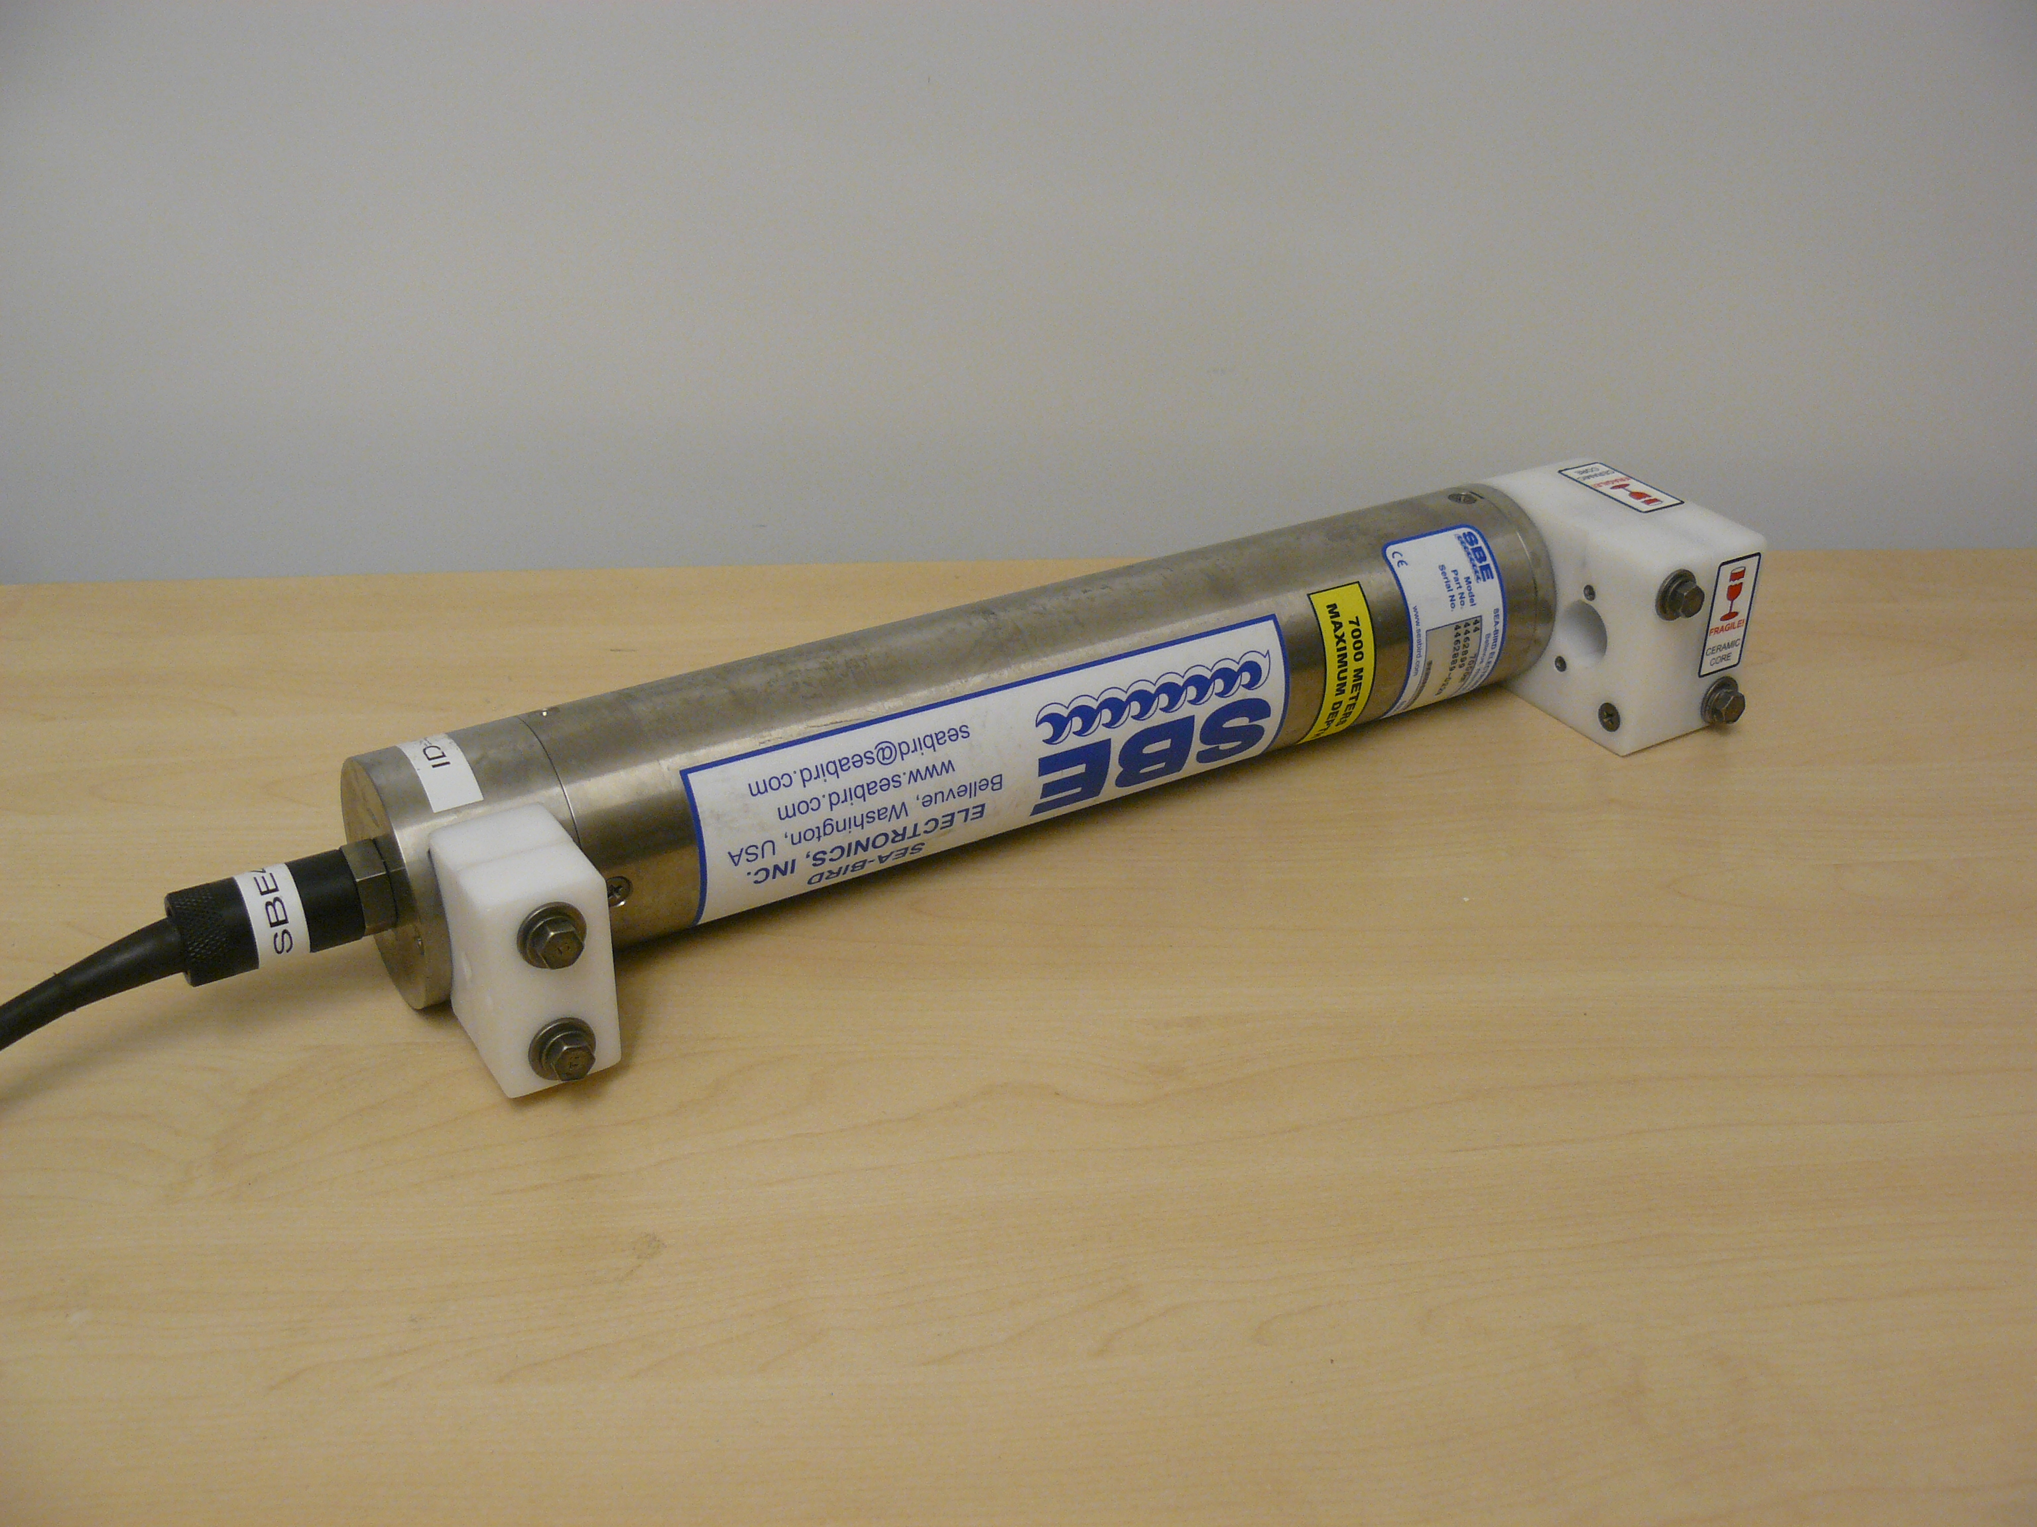
Planned OA Deployments
Palmyra Atoll
Moorea LTER
Martz SeapHox: pH, conductivity, temperature
Pro-Oceanus CO2-Pro: PCO2
MBARI-modified: pH
Sea-Bird Inductive Modem

Slide 19
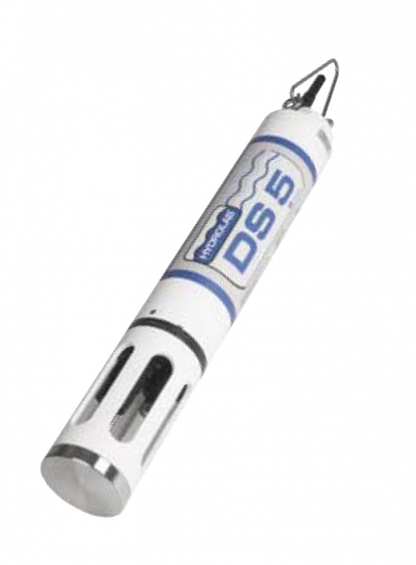
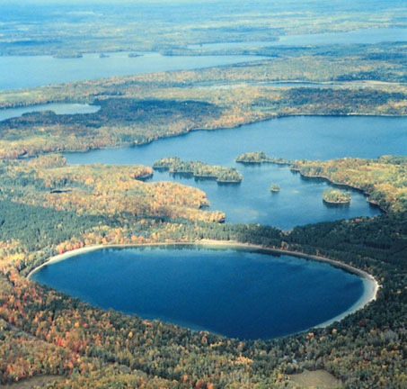
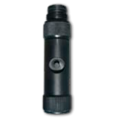
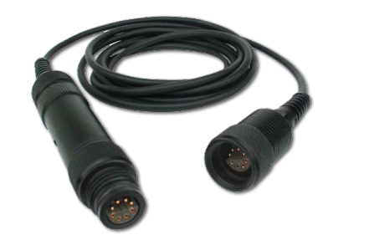
Planned Lake Deployment
Hydro-lab DS-5: chlorophyll, dissolved oxygen
NexSens T-Node: temperature
NTL LTER

Slide 20
Sensor-Rocks: Sensor Network Software O&M Automation
Sameer Tilak and Philip Papadopoulos

Slide 21
Current Software O&M Approach
The state-of-the-art approach relies on system administrators to build and manage these footprints as golden images that are then burned into similar sensors either in the lab or using Over The Air Programming (OTAP)
Current manual software O&M approach does not guarantee reproducibility and does not scale!

Slide 22
Motivation: Automating Sensor Device and Network Definition
Inexpensive sensor devices have no interactive screens and must therefore be configured only using a flashed-system image for which there exist only hand-build techniques today for this step
Scaling to 100s or 1000s of sensors means that we must be able to handle hardware heterogeneity of individual sensors without the time-consuming process of building a highly-customized, independent image for each variant; and
We want better reproducibility of the basic software configuration so that we can easily adjust to the rapid changes of the Android environment and reap the benefits of new capabilities.

Slide 23
Rocks Background
Rocks is a software toolkit that solves the computing cluster definition, deployment and management problem and has reduced the time from raw hardware to a working system within the Data Centers from days/weeks to a few hours.
The toolkit treats a complete software footprint on any machine as a set of software packages and configuration that together form a Rocks Appliance (e.g., database, parallel file servers, load managers, software routers). Appliances can share packages and configuration.

Slide 24
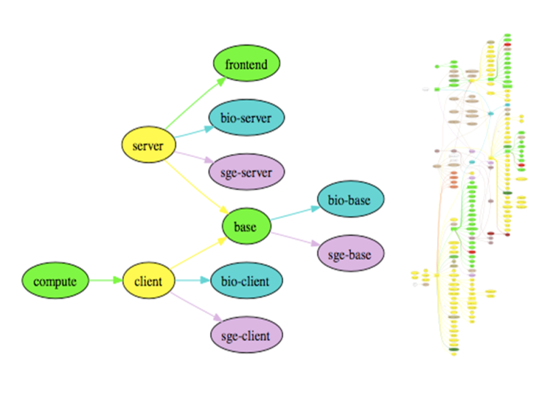
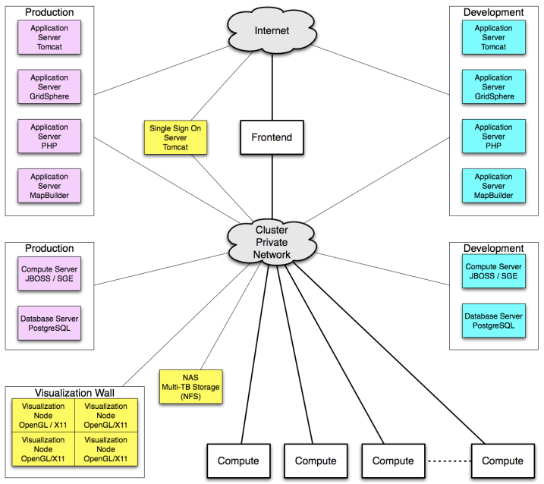
Data Center Configuration using Rocks
A Portion and a Complete Rocks Config. Graph. Software installation on a given node is performed through the traversal of the configuration graphs.
A Rocks-based sample Data center architecture

Slide 25
Research Questions
How can you develop a scalable and programmatic mechanism to define software footprint of individual sensors and sensor networks such that it guarantees reproducibility of sensor network cyberinfrastructure?
Can you take a software tool designed to define systems (clusters) in a “friendly” data center environment and scale it down to resource-constrained sensor networks without losing its expressiveness?
Hypothesis: Sensor-Rocks- Modular system footprint construction will become essential as system complexity grows

Slide 26
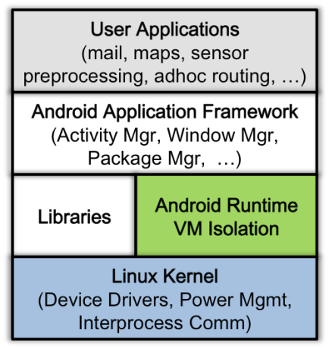
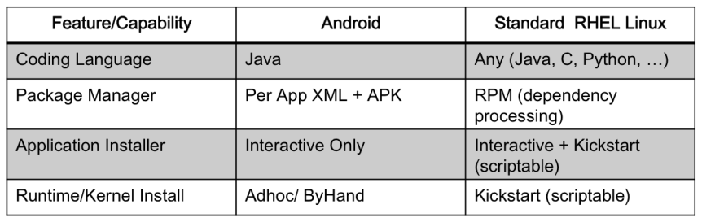
Android Software Stack
Android application and kernel stack
key system definition differences between Android
and Full Linux
No scriptable system definition framework like Redhat's Kickstart exists today for Android
Unlike installed Linux systems, common tools for modifying configuration files via scripting languages are not part of the installed Android environmet. This means that Linux can be used to automatically define and configure itself (this is what happens when you install from a DVD)nt, but Android does not have the same closed form.

